Slide 1


COMPASS: A Programmable Data Prefetcher Using Idle GPU Shaders
Dong Hyuk Woo
Hsien-Hsin S. Lee
Georgia Tech ECE

Slide 2
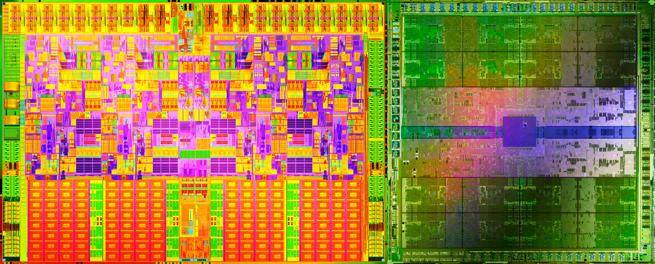
Integrated GPU

Slide 3
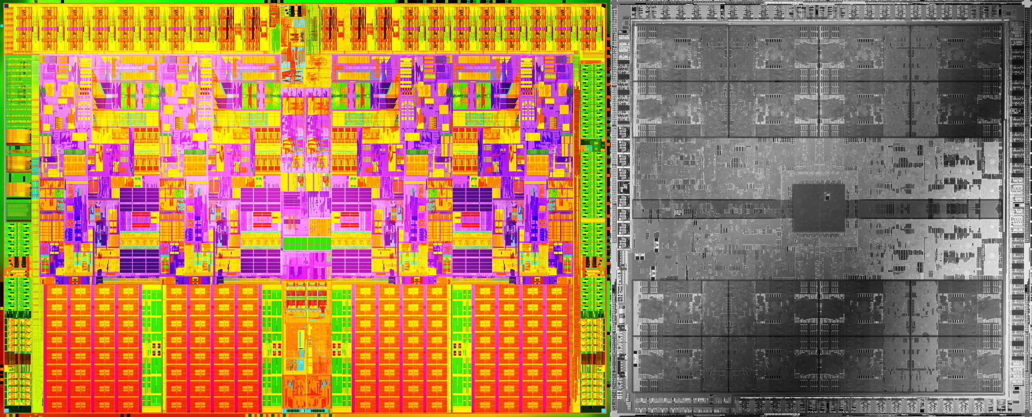
Idle Integrated GPU
Z
Computation-intensive applications
Boost the CPU clock frequency
Memory-intensive applications?
Z
Z
Z

Slide 4
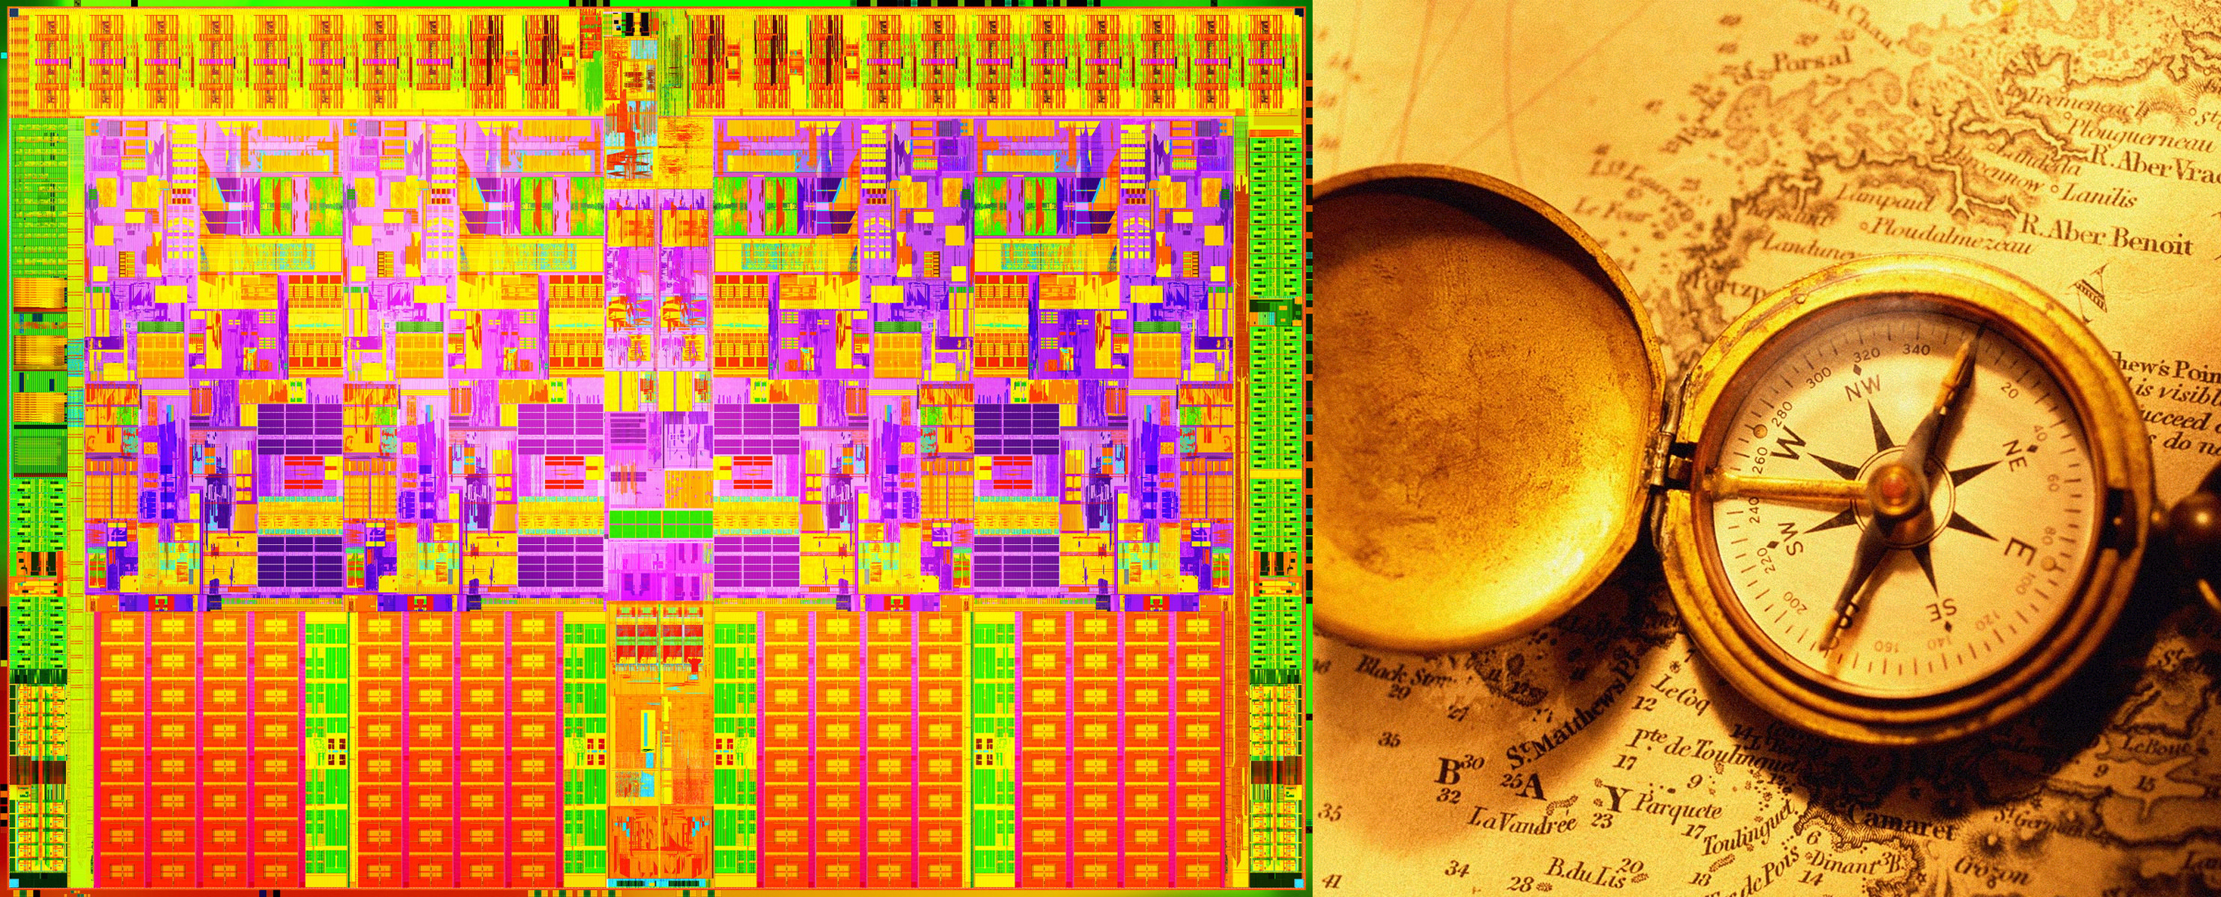
Compute Shader Assisted Prefetching
Mimic a hardware prefetcher
Programmable prefetcher w/ compute shader
Best-effort service enabled by an OS

Slide 5

Baseline Architecture

Slide 6
Baseline GPU Architecture
A Shader Core (= 5 SPUs)
Command Processor
Setup Engine
Inst. $
Const. $
Br
Ultra-Threaded Dispatch Processor
Register File
A Streaming
Processing
Unit (SPU)
LDS
TEX
Unit
L1
TEX$
x-
bar
L2$
Bank0
LDS
TEX
Unit
L1
TEX$
L2$
Bank1
LDS
TEX
Unit
L1
TEX$
L2$
Bank2
LDS
TEX
Unit
L1
TEX$
L2$
Bank3
Render Back-Ends
A SIMD Array (= 80 SPUs)

Slide 7
Baseline Platform
Command Processor
Core 0
Core 1
GPU
Setup Engine
Inst. $
Const. $
Ultra-Threaded Dispatch Processor
LDS
TEX
Unit
L1
TEX$
x-
bar
L2$
Bank0
L2$
Bank 0
L2$
Bank 1
L2$
Bank 2
L2$
Bank 3
LDS
TEX
Unit
L1
TEX$
L2$
Bank1
LDS
TEX
Unit
L1
TEX$
L2$
Bank2
MC 0
MC 1
LDS
TEX
Unit
L1
TEX$
L2$
Bank3
MC 2
MC 3
Render Back-Ends

Slide 8
COMPASS Usage Model

Slide 9

Profile and Select the Best Shader
?
Stride
Markov
Delta
Region
A
♣
A
♦
A
♠
A
♥
A
♣
A
♦
A
♠
A
♥

Slide 10

Application Provider’s Choice
Use stride!
Stride
Markov
Delta
Region
A
♣
A
♦
A
♠
A
♥
A
♣
A
♦
A
♠
A
♥

Slide 11

Application Provider’s Custom Shader
Use my joker!
Stride
Markov
Delta
Region
A
♣
A
♦
A
♠
A
♥
★
mcf
A
♣
A
♦
A
♠
A
♥
★♥

Slide 12
COMPASS Execution Model

Slide 13
Step 1: Shader Setup
Miss Address Provider (MAP)
Use stride!
Shader pointer
Core0
Core1
GPU
MAP
L2$
Bank0
L2$
Bank1
L2$
Bank2
L2$
Bank3
Upon context switching (or a program phase change)

Slide 14
Step 2: Prefetcher Access
Command
Buffer
Shader pointer
Miss PC
Miss Address
Core0
Core1
GPU
MAP
L2$
Bank0
L2$
Bank1
L2$
Bank2
L2$
Bank3
Upon a miss or the first hit to a prefetched line

Slide 15
Step 3: Indexing (Selecting a Thread)
HW thread 0
Prefetch table
Command Processor
PC
Setup Engine
Inst. $
Const. $
Ultra-Threaded Dispatch Processor
HW thread N-1
LDS
TEX
Unit
L1
TEX$
x-
bar
LDS
TEX
Unit
L1
TEX$
LDS
TEX
Unit
L1
TEX$
LDS
TEX
Unit
L1
TEX$
Render Back-Ends

Slide 16
Step 4: Execute a COMPASS Shader
tag
lastAddr
stride
tmp
HW thread 0
Command Processor
HW thread 1
tag
lastAddr
stride
tmp
Setup Engine
tag
lastAddr
stride
tmp
HW thread 2
Inst. $
Const. $
Br
tag
lastAddr
stride
tmp
HW thread 3
Ultra-Threaded Dispatch Processor
Register File
LDS
TEX
Unit
L1
TEX$
x-
bar
if (tag == missPC) {
tmp = lastAddr + stride
if (missAddr == tmp) prefetch [missAddr + stride]
}
tag = missPC
stride = missAddr – lastAddr
lastAddr = missAddr
LDS
TEX
Unit
L1
TEX$
LDS
TEX
Unit
L1
TEX$
LDS
TEX
Unit
L1
TEX$
Render Back-Ends

Slide 17
Step 5: Prefetch!
Command Processor
Setup Engine
Inst. $
Const. $
Ultra-Threaded Dispatch Processor
LDS
TEX
Unit
L1
TEX$
x-
bar
LDS
TEX
Unit
L1
TEX$
LDS
TEX
Unit
L1
TEX$
LDS
TEX
Unit
L1
TEX$
Render Back-Ends

Slide 18
Opportunities and Challenges of COMPASS

Slide 19
Opportunities and Challenges
+ Large table supported
+ Ample bandwidth available
+ Flexibility
+ Customizability
- High latency
- Low throughput

Slide 20
High Latency and Low Throughput
Wavefront A, thread i
High latency
Lower clock frequency
Multi-threading
Low throughput
A series of instructions to emulate one prefetcher operation
Wavefront A, thread 16+i
Wavefront A, thread 32+i
Wavefront A, thread 48+i
Wavefront B, thread i
Wavefront B, thread 16+i
Parallel COMPASS shader!
Deeper prefetching!
Wavefront B, thread 32+i
Wavefront B, thread 48+i
Wavefront A, thread i
Wavefront A, thread 16+i
time
Parallel COMPASS shader!
Different index function!

Slide 21
Experimental Results

Slide 22
Simulation Framework
CPU (3GHz)
14-stage, OoO, 4-wide issue
2-way 32KB IL1$, 4-way 32KB IL1$
GPU (1.5GHz)
4 SIMD, 16 shader cores / SIMD, 5 SPUs / shader core
Total 320 SPUs
4-banked, 16KB register file / shader core
Total 1MB
Shared, 4-banked, 8-way 2MB L2$ w/ a next-line prefetcher

Slide 23
Stride COMPASS (462.libquantum)
0-lat, inf-thr
(PC+addr)
n-thread
(PC+addr)
0-lat, inf-thr
PC-only
1
1
1
0
1
0
1
0
stride 64
PC+MissAddr
n-thread
1
0
1
0
1
0
0
0
stride 256
0
1
stride 256
1
0
stride 256
1
1
stride 256
1-thread

Slide 24
Overall Result
Gems-
FDTD
GMean
lib-
quantum
omnetpp
mcf
astar
xalan
bwaves
milc
leslie3d
soplex
calculix
Stride
1.06
2.69
1.15
1.07
0.93
1.84
1.15
1.27
1.34
1.12
1.11
1.28
Markov
0.97
0.74
1.22
0.82
1.18
0.73
0.87
0.69
0.86
0.91
0.60
0.85
Delta
1.33
1.13
1.15
1.05
0.93
1.61
4.22
1.26
1.31
1.10
1.70
1.38
Region
2.00
3.49
0.25
1.09
0.82
1.46
1.59
1.23
1.47
1.12
0.30
1.07
mcf
1.61
n/a
n/a
n/a
n/a
n/a
n/a
n/a
n/a
n/a
n/a
n/a
On average, 68% improvement when properly selected

Slide 25
Conclusion
An idle GPU as a programmable prefetcher
Very large resources available
Ample bandwidth available
Flexibility
Customizability
Extremely little hardware overhead
68% improvement on average

